Slide 1
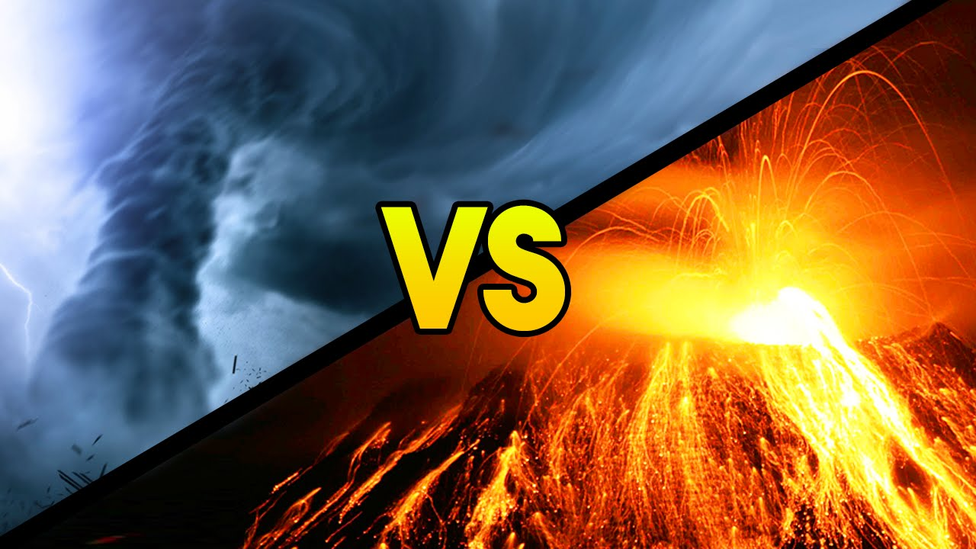
Visualizing Natural Disasters
Presented by: Connor Geslin Carson Sorensen Brennon Netz

Slide 2
Overview and Goals
Goals
Understand and visualize natural disasters.
Create compelling and visually pleasing visualizations of disasters.
Use tools we have learned in class such as VTK and ParaView to assist us
Make and interesting Project.
Overview
Used ParaView and VTK to visualize a tornado dataset using streamlines
Used ParaView to make a time series visualization of ash and SO2 in the air after a volcanic eruption.

Slide 3
Description of Data
Volcano Data: http://www.viscontest.rwth-aachen.de/
200 files
Taken from satellites in Earth’s atmosphere. Near global coverage
Data was gathered from June 1, 2011 to August 31, 2011.
Each file represents a time frame of 12 hours.
Two eruptions and the aftermath of one eruption took place in the time frame of the data
May 21, 2011 Grímsvötn eruption in Iceland (our data starts on June 1, but aftermath can be seen)
June 4, 2011 Puyehue-Cordón Caulle eruption in Chile.
June 12, 2011 Nabro eruption near the Eritrea-Ethiopia border
Tornado Data: https://cgl.ethz.ch/research/visualization/data.php
VTI file format
3D visualization of a tornado

Slide 4


Tools/Libraries

Slide 5
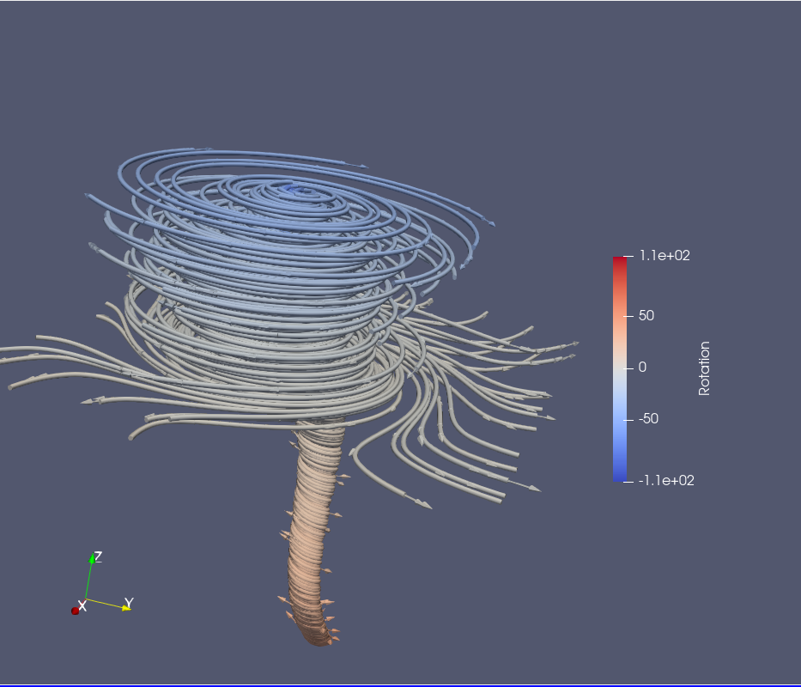
Streamlines and Glyphs Colored by Rotation

Slide 6
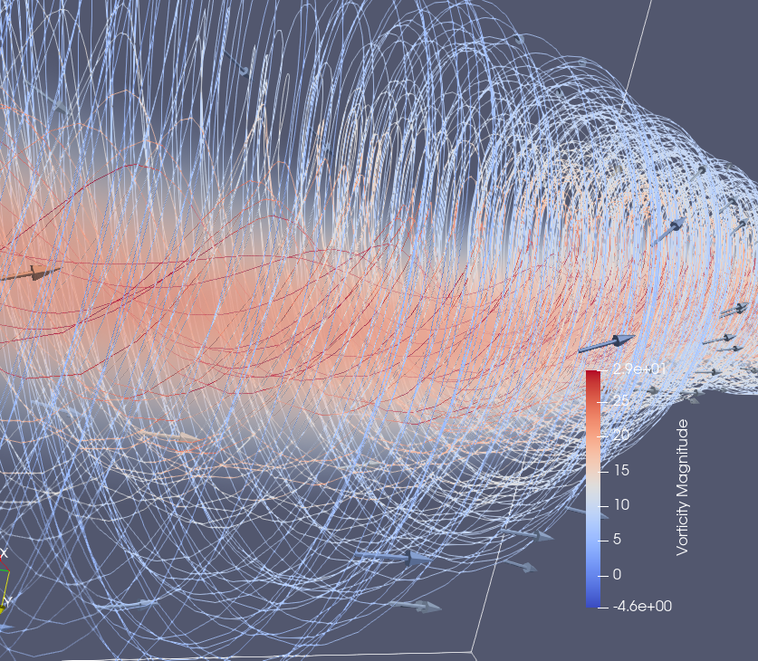
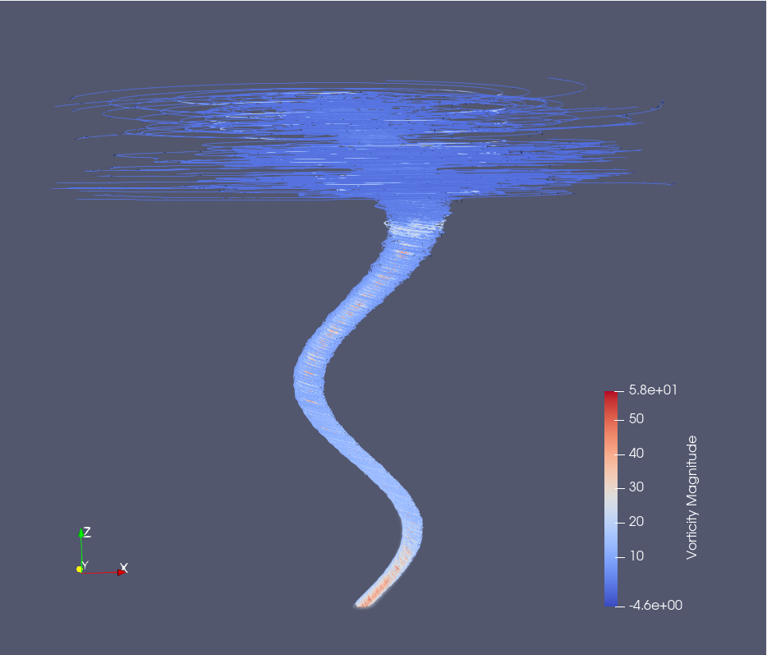
Streamlines and Glyphs Colored by Vorticity

Slide 7
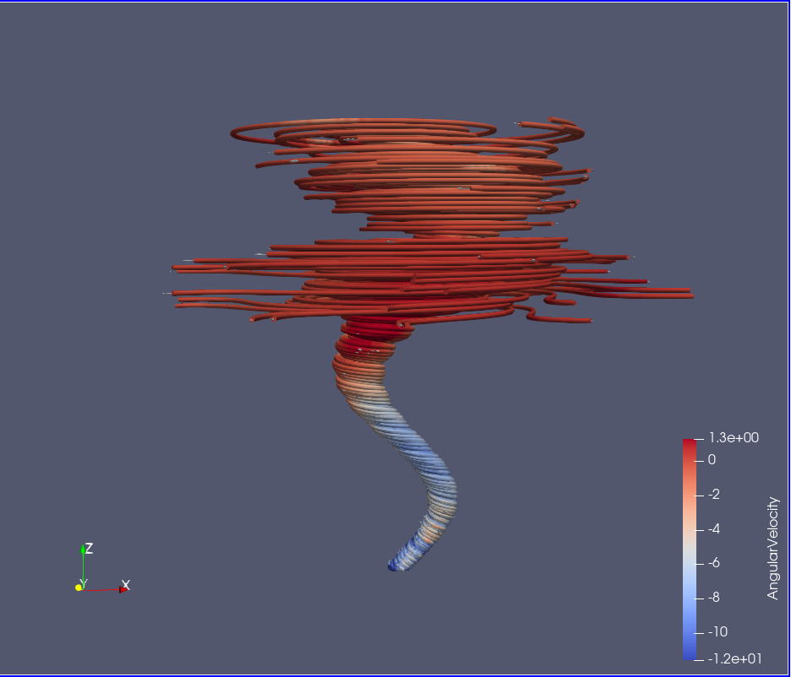
Streamlines and Glyphs Colored by Angular Velocity

Slide 8
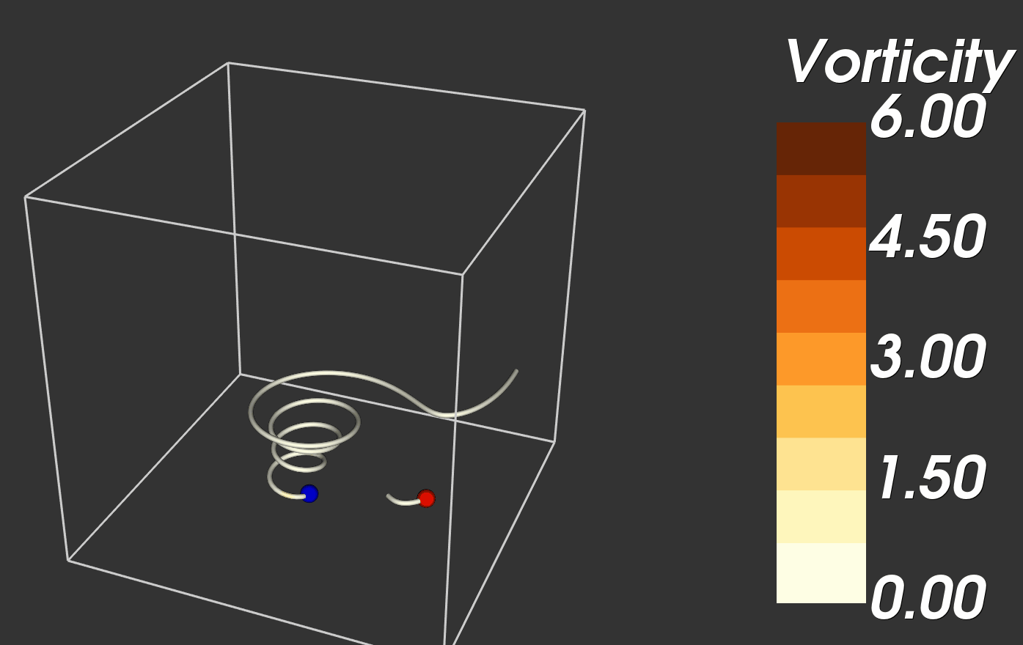
VTK Tornado and Live Demo

Slide 9
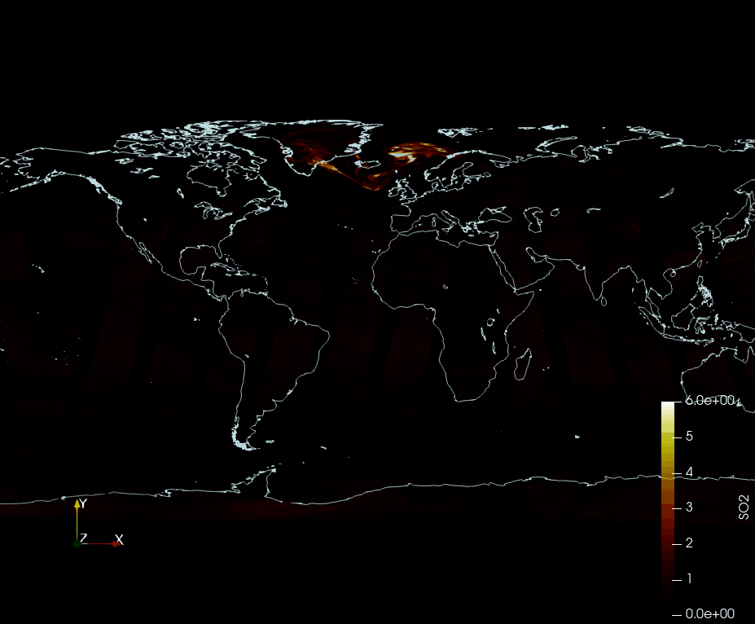
Volcanic eruptions SO2

Slide 10
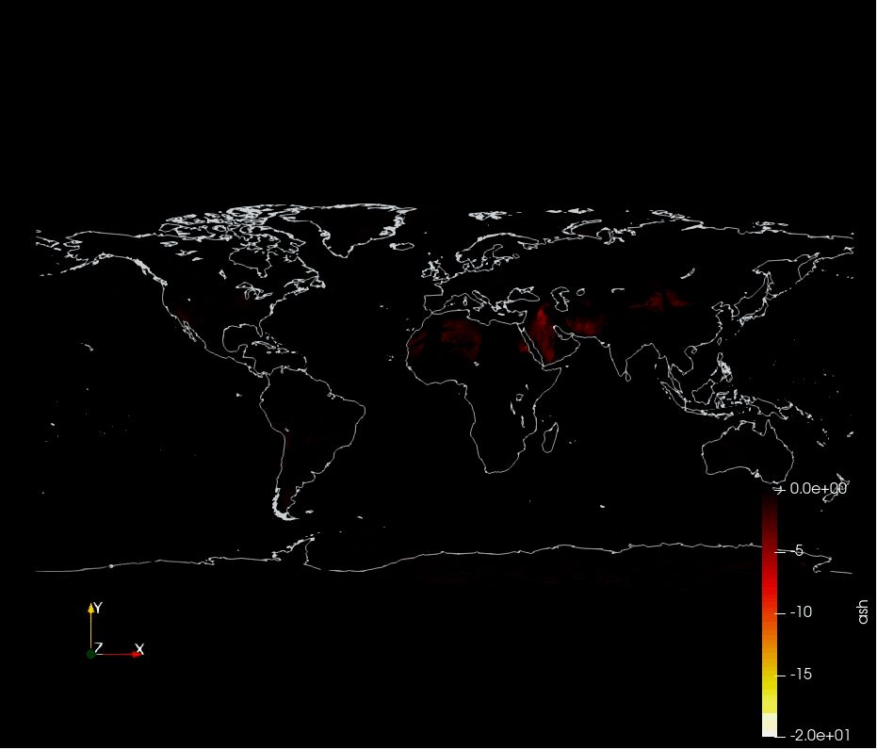
Volcanic eruptions ash

Slide 11
Scientific Questions Answered
Are the atmospheric effects of a volcano localized or do they spread across the globe?
After a volcanic eruption, the S02 and Ash can be seen traveling across the entire world
How long are the effects of a volcano seen in the atmosphere
Ash and S02 were detected in the atmosphere between 15 and 20 days for each eruption
Where is the vorticity in a tornado the highest?
Vorticity is higher closer to the center of a tornado and the closer to the ground
Where is the rotation speed the highest in a tornado?
The rotation speed increases as you get nearer to the ground

Slide 12
Challenges
Getting the volcano time series to work nicely with paraview
Color scheme in VTK
Creating a vector to draw streamlines from for the tornado dataset in VTK and ParaView
Downloading the volcano data and sharing it with the group
The volcano data does not have complete global coverage. There are chunks missing in low elevation areas. Getting around this by choosing a color scheme that masks the missing data
Showing the effects of the volcano while ignoring false positives
I.e., dust from the Sahara Desert shows up as Ash in the data
Getting the color schemes of the streamlines on the tornado correct

Slide 13
Changes to initial plan
We did not end up having to make any changes from our initial plan. We were able to answer all of the questions that we had when we made our proposal.

